Slide 1

Aspects of MLP

Slide 2
Recap…
We have learnt about perceptrons…
Perceptron learning rule
Limitation that it can only classify linearly separable data
We have learnt something about multilayer perceptrons
Backpropagation learning rule
Forward pass, backward pass…

Slide 3
MERITS OF AN MLP

Slide 4
Merit #1: A general solution to a large class of problems.
NN vs. Algorithmic Approach
Traditional or Algorithmic Approach
Study and find out the steps to produce a final output from a given input
NN Approach:
Learn from Experience
Since it only depends on data and not on prior understanding of the underlying processes of a system, it can be applied to a wide variety of domains.
Good when no model is available

Slide 5
Applications Domains of NN
Signal & Image processing, and communications
Control & robotics
Manufacturing industry
Power systems
Financial sector
Oil exploration
Consumer goods: cameras, washing machines, microwave ovens, ...
Automotive industry
Medicine
Biology

Slide 6
Merit #2:It is a “Universal Approximator”
Given enough number of hidden neurons, it can learn most practical problems

Slide 7
Universal Approximation Theorem:
Let g(.) be a nonconstant, bounded, and monotone-increasing continuous function.
Let Im denote the m-dimensional hypercube [0,1]^{m}.
The space of continuous functions on Im is denoted by C(Im).
Then given any function f in C(Im) and ε > 0, there exist an integer M
and sets of real constants ai, bi and wij,
where I = 1, …,n, qnd j = 1,…,m such that we may define:
As an approximate realization of the function f(.); that is,
| F(x₁,…, x_{m}) – f(x₁,…,x_{m})| < ε
for all x₁,…, x_{m} that lie in the input space.

Slide 8
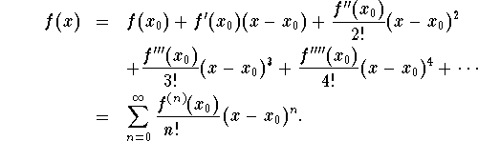
Other familiar results in Engineering Mathematics
Taylor series:
The greater the number of terms in the expansion, the more accurate is the representation.

Slide 9
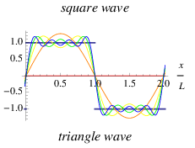
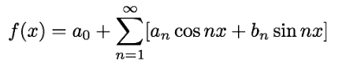
Other familiar results in Engineering Mathematics
Fourier series:
The greater the number of terms in the expansion, the more accurate is the representation.

Slide 10
Merit #3: Backprop algo works for any feedforward network
BP will work for any neural network that does not have LOOPS
Signal
Not just this
BP will work for this too

Slide 11
Merit #4: Discovers “creative” solutions
Hidden units act as “feature detectors.”
Example:
NETTALK: An MLP that can read text aloud
Speech
Neurons in the hidden layer automatically learnt to
Distinguish between “vowels” and “consonants”
The training does not convey
the concept of vowels and consonants
Signal
Text

Slide 12
DEMERITS OF MLP

Slide 13
Demerit #1: Blackbox approach
Output
We can only control input and output
No control over what happens inside the network
The network behaves like a “blackbox”
Signal
Input

Slide 14
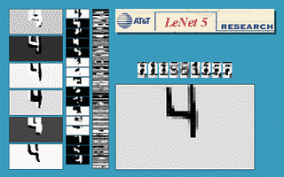
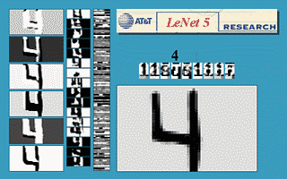
Demerit #2: Limits of Generalization not clear
Generalization means “recognizing patterns that are not present in the training set”
Learnt to recognize 4 at new positions
- “translation invariance”
Learnt to recognize 4 at new sizes
- “scale invariance”

Slide 15
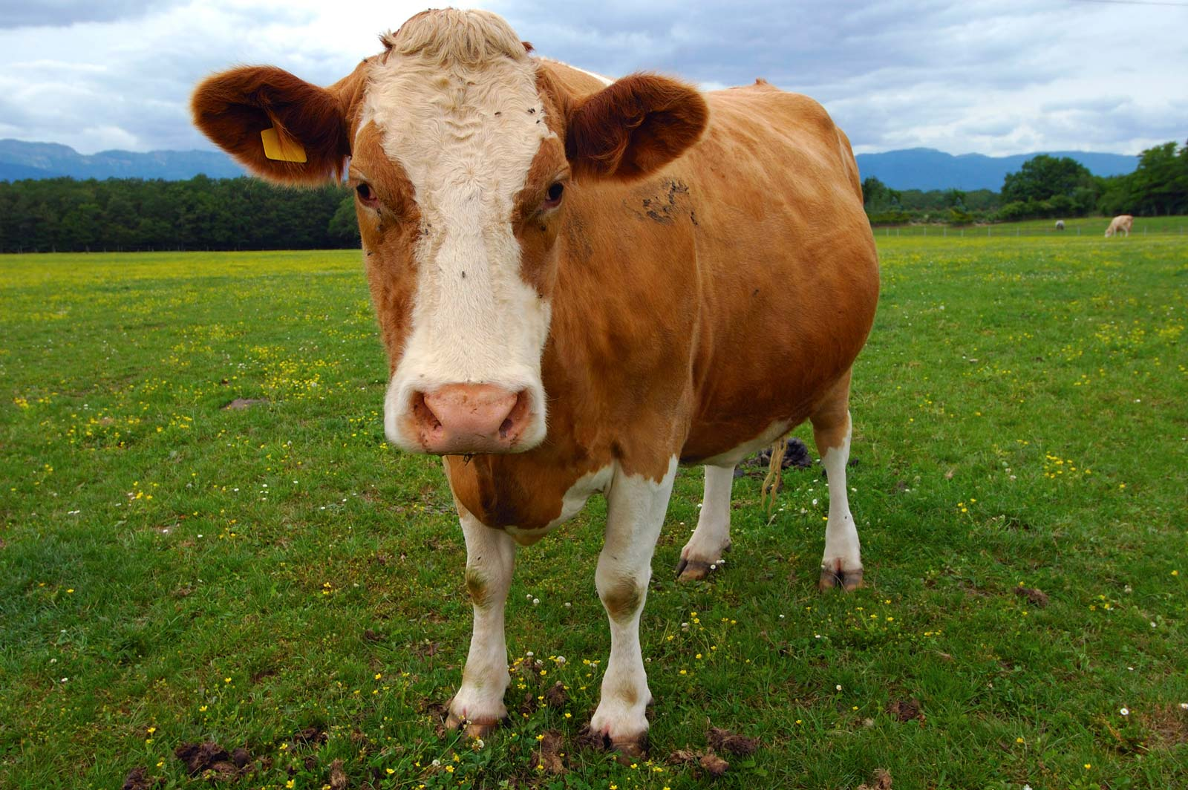
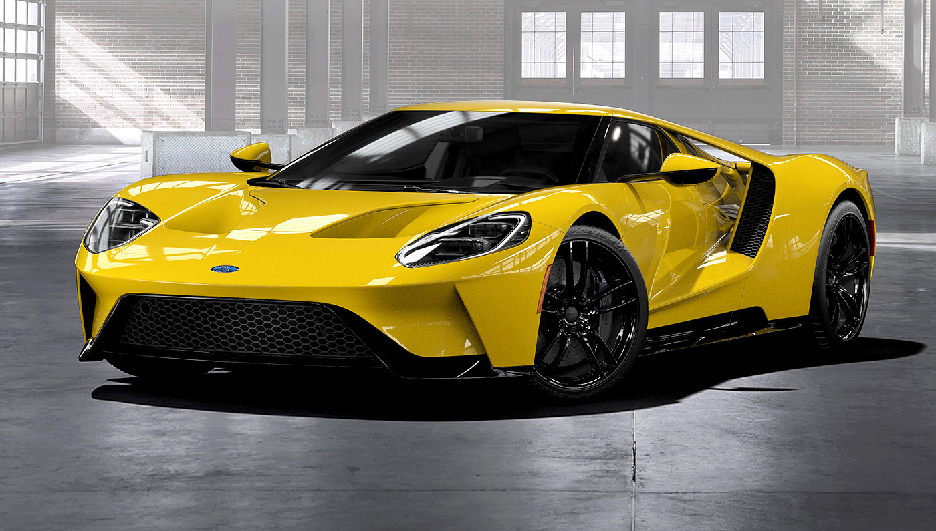
Need not always work so well!
“Cow”
“Cow”?
MLP
MLP
Has
2 ears
2 eyes
4 legs
A mouth
?

Slide 16
Demerit #3: Local minima
Error landscape
Since Backprop works by gradient descent
It can get stuck in local minima
Local minima
Global minimum

Slide 17
May not always be a problem, because…
Output
Output
Imagine that:
Neurons are like beads
Weights are like strings
Permute the hidden neurons
The new network will be identical
To the older network in its I/O function
Conclusion: For every MLP with n hidden neurons,
there must be n!-1 other MLPs that are identical
Hence, there must be a large number of good solutions, if n is large
Input
Input

Slide 18
Development of an NN Application
The Stages
Feasibility study
Data collection
Designing/Training the Network
Testing the Network
Deployment...

Slide 19
Feasibility Study
Do you really need a NN?
Occam’s razor principle: More things should not be used than are necessary.
Is it an I/O problem?
What are the inputs and the outputs?
Can they be expressed as vectors?
Are inputs and outputs uniquely related?
Do I have enough domain knowledge?
Do I have enough Data?

Slide 20
Domain Knowledge
Can never overemphasize the value of Domain Knowledge
Domain Knowledge is used to -
Breaking up the problem
Map problem onto NN(s)
Data collection
Data preprocessing

Slide 21

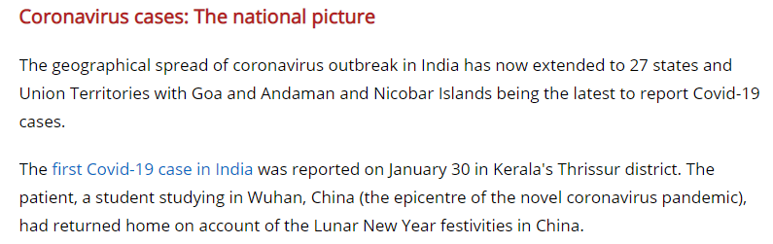
Ex: Optical Character Recognition
(Line to word segmentation (Algorithm)
(Word to Character segmentation (Algorithm)
Text to Line Segmentation
(Algorithm)
n
Text and Image
Segmenation
Neural Network
Character Recognition
Neural Network

Slide 22
Data
Knowledge in Data ==> Knowledge in NN
Data must be-
Abundant
real data
simulated data
Comprehensive
include all possible cases
Reliable
Right representation is the key
Training
Data
Neural
Network

Slide 23
Data Preprocessing
Representation
Ex: 1) Classifying integers as odd/even:
In binary representation, answer lies in the last bit
In base 10 representation, it is more complicated
Remove irrelevant or redundant information
Normalization, scaling,...
Reduce input dimension
Principal component analysis
Feature extraction

Slide 24
Designing/Training the Network
Architecture
Initialization
Training
Pruning

Slide 25
Architecture
Feedforward Network:
MLP:
1 hidden layer?
2 hidden layers?
hidden layers > 2?
Customized architecture?

Slide 26
How many Hidden Layers?
Single hidden layer is enough to learn a continuous function over a finite domain.
But, with more hidden layers you can obtain a hierarchical representation – as it happens in deep neural networks

Slide 27
Training & Pruning
Training procedure
Backpropagation
adaptive learning rate
momentum,...
Higher-order methods
Batch mode: update weights once an epoch
memory intensive
greater chance of getting stuck in local minima
Sequential mode: update weights after every input presentation
lesser memory requirement
stochastic - lesser chance of local minima

Slide 28
When to stop training?
Early Stopping
Train
Error < a minimum.
Rate of change in error averaged over an epoch < a minimum.
Magnitude of gradient ||g(w)|| < a minimum.
Early stopping: When performance over a test set has peaked.
Validation
Error
Time
STOP

Slide 29
Generalization &Testing
The problem of generalization
U
F
NN
T
X
Cross-validation
Caution: Specify explicitly the conditions
under which the network was trained

Slide 30
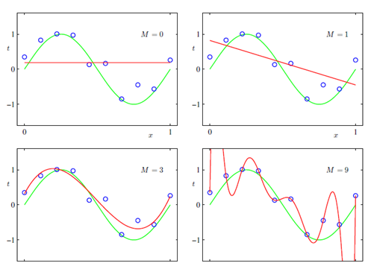
Fitting polynomials to data
https://towardsdatascience.com/regularization-an-important-concept-in-machine-learning-5891628907ea

Slide 31

Bad training performance
Bad generalization
Good training performance
Good generalization
Good training performance
Bad generalization

Slide 32
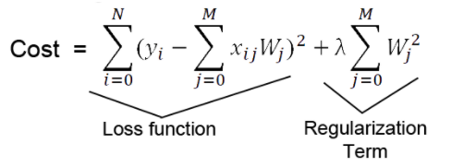
A strategy for good generalization
Overall Cost = training error + lambda * cost_of_large_weight_values
Regularization

Slide 33
Pruning
Removing network, weights and neurons for improving generalization:
weight decay
Optimal Brain Damage (OBD)
A higher order (based on II derivative of Error) method for determining which weights are expendable

Slide 34
Summary
Merits and Demerits of MLP
Architecture
Training
Testing/Generalization

